Slide 1

Probability and Odds
Notes:
In this presentation we will review the topics of probability and odds which we will use later on for discussing classification models.

Slide 2
Terminologies
Probability (P) – is the likelihood that an event will occur.
Outcomes – when you do a probability experiment the different possible results are called outcomes
Event – is a collection of outcomes
Notes:
Let’s start by defining some terminology; so, the first terminology is probability, which is also represented by p. Probability is the likelihood that an event can occur. Then we will have the outcome, generally when we do probability experiments, the different possible results are called the outcomes. Finally, event is the collection of outcomes.

Slide 3
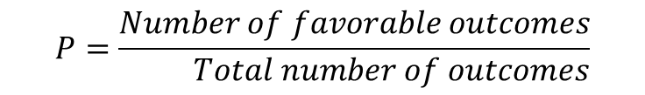
Probability
Probability can be expressed as a ratio of the number of favorable outcomes divided by the total number of outcomes
$$P=\frac{Number of favorable outcomes}{ Total number of outcomes}$$
Notes:
Probability can be expressed as the ratio of the number of favorable outcomes divided by the total number of outcomes.

Slide 4
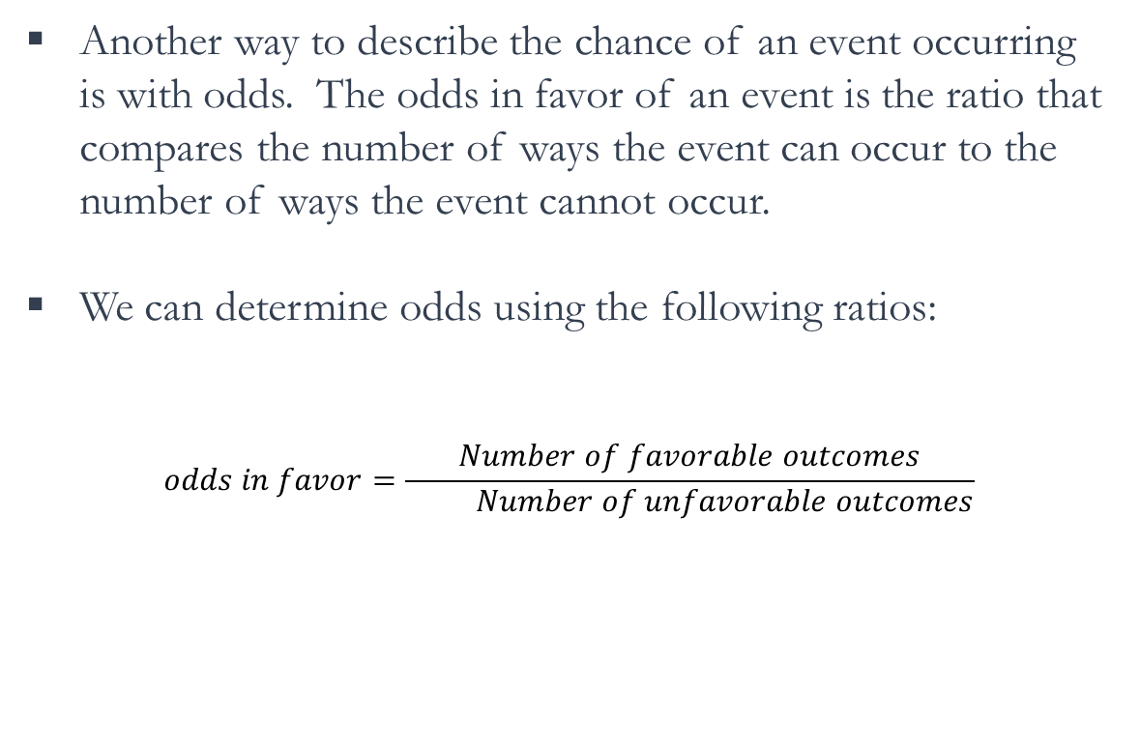
Odds
Another way to describe the chance of an event occurring is with odds. The odds in favor of an event is the ratio that compares the number of ways the event can occur to the number of ways the event cannot occur.
We can determine odds using the following ratios:
$$odds in favor=\frac{Number of favorable outcomes}{ Number of unfavorable outcomes}$$
Notes:
Another way to describe the chance of an event occurring is with odds. The odds in favor of an event is the ratio that compares the number of ways the event can occur to the number of ways that the event could not occur. We can define the odds in favor of an event as the ratio of the number of favorable outcomes to the number of unfavorable outcomes.

Slide 5
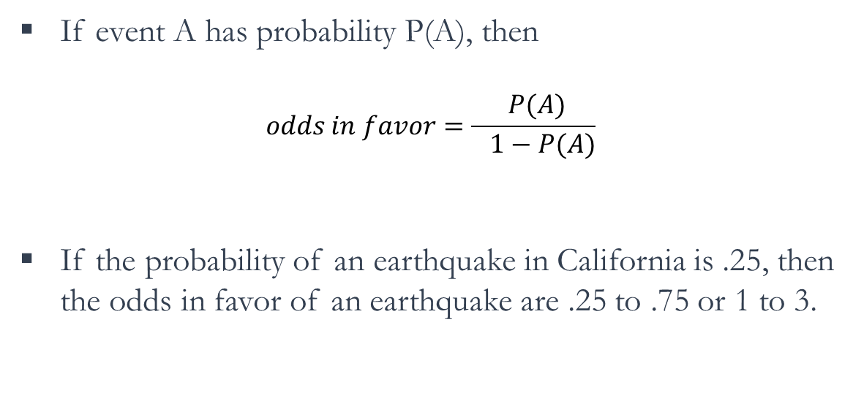
From Probability to Odds
If event A has probability P(A), then
$$odds in favor=\frac{ P(A)}{ 1−P(A)}$$
If the probability of an earthquake in California is .25, then the odds in favor of an earthquake are .25 to .75 or 1 to 3.
Notes:
Knowing the probability, one can easily calculate the odds in favor of an event. In fact, the odds in favor of an event, is equal to the probability of the event divided by one minus the probability of the event. For example, if the probability of an earthquake in California is 0.25, then the odds in favor of an earthquake are 0.25 to 0.75 or 1 to 3.

Slide 6
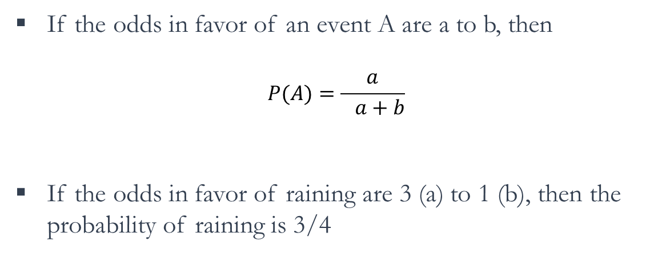
From Odds to Probability
If the odds in favor of an event A are a to b, then
$$P(A)=\frac{a}{ a+b}$$
If the odds in favor of raining are 3 (a) to 1 (b), then the probability of raining is 3/4
Notes:
Similarly, knowing the odds in favor of an event, one can easily calculate the probabilities. In fact, if the odds in favor of event A, are A to B, then the probability of event A is A divided by A + B. For example, if the odds in favor of raining are 3 to 1, then probability of raining can be calculated as 3 divided by 4.

Slide 7
Test Your Knowledge
Which of the following statement is correct
Odds can only vary between 0 to 1
Probability varies in range 0 to +∞
Odds varies in range -∞ to +∞
None of the above
The answer is D. Remember that probability is always between 0 to 1 and the odds varies in range 0 to +∞

Slide 8
“The 50-50-90 rule: anytime you have a 50-50 chance of getting something right, there's a 90% probability you'll get it wrong!! ” ― Andy Rooney
In predictive analytics, various algorithms are deployed to mine data to find patterns with the goal making predictions.
Predictive analytics systems deploy more complex algorithms and are more computationally intensive
In Predictive Analytics systems the focus is in predicting the future as opposed to describing what has happened in the past which is the focous of BI systems.

